Slide 1
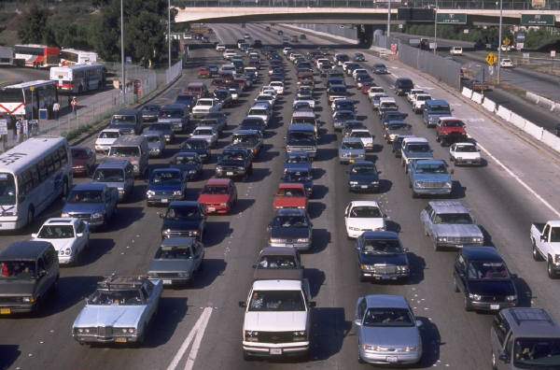
Hydraulic Traffic System Design
Rajiv Lochan Baruah
Mandeep Deka
2nd Semester
Dept. of Mechanical Engineering
NIT Silchar

Slide 2
Problem Statement
Suppose in a three way junction of a road, highway or bridge there are several instants where the traffic flowing through any of the one route is very high comparative to other two lanes. In such a situation if time clock controlled traffic mechanism is placed into action the situation get worse than before as more and more vehicles accumulate upon a road which is already heavily packed.

Slide 3
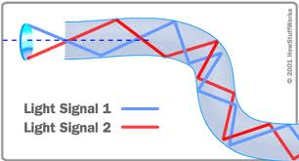
INSPIRATION
FOR
SOLUTION
Problems of Traffic jams in India
Use of optical fibers in designing automated traffic signal system

Slide 4
Solution: We have here designed a plan entirely controlled up hydraulics and simple electric circuits. In this kind of a hydraulic regulated traffic system preference of clearance of lanes will be given to the one through most number of cars accumulate in a specified time.
KEY
Hydraulic Zone
Vehicles
TOP VIEW OF THE HYDRAULIC TRAFFIC SYSTEM

Slide 5
Working Mechanism
Working is based on the basic application of Pascal’s law i.e. if stated mathematically is F1/A1=F2/A2
As more number of vehicles accumulate on the road, magnitude of F1 increases. This make the cylinder full of fluid to suppress a little. As the volume of water remain constant the push on the piston of smaller cross area is more though the though the force acting on it less. This push is then utilized to complete an electric circuit that will make the traffic signal go green. Subsequently as the traffic reduces there may be development of traffic on the other two lanes. The cylinder of the three lanes will be interconnected to each other and through some manual operation , the pressure generated in the other two water columns may be used to push the piston of cylinder one down and circuit is consequently broken and traffic signal go red .
Traffic signal
Electric mechanism that will use the push of the piston to complete the electric circuit that will make traffic signal turn green
Vehicles pushing the cylinder down
Road Level
F1
fluid
F2

Slide 6
THANK YOU

